Slide 1
Spark Standalone Application
Pravin Y Pawar

Slide 2
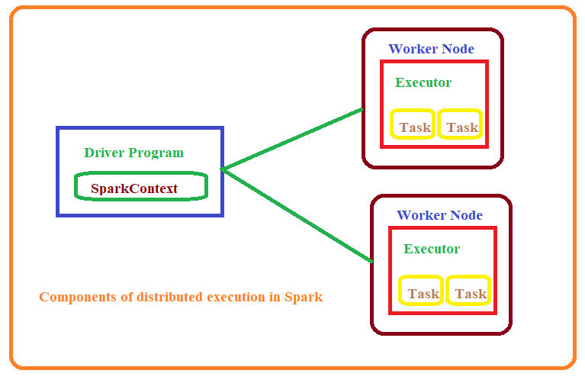
Core Spark Concepts
Components of distributed execution

Slide 3
Core Spark Concepts (2)
Driver Program
Every Spark application consists of driver program that launches various parallel operations on a cluster
Driver program
contains main function
defines distributed datasets on cluster
then applies actions to them
Shell is the driver program, hence able to do operations in it
Driver program access Spark through SparkContext object, which is connection to the cluster
In shell, SparkContext is automatically created and accessed as “sc”
SparkContext is used to build RDDs
RDDs can be used to run various operations on them
To run these operations, driver program manage number of nodes called executors
Executors will be present on the different nodes

Slide 4
Standalone Applications
Using Python
Spark can be linked into standalone applications in Java, Scala or Python
Need to initialize the SparkContext in program
After that API is same!
In Python,
Simply write applications as Python scripts
Run them using the bin/spark-submit script
Spark-submit includes the Spark dependencies in Python
Sets up environment for Spark’s Python API to function
Need to have pyspark package installed on the system

Slide 5
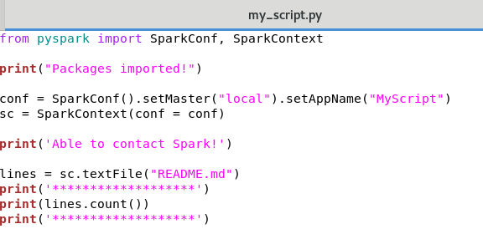
Standalone Applications(2)
Initializing and Using SparkContext
Import the packages in program
Create SparkConf – to configure the applications
Create SparkContext
A cluster URL, which tells Spark how to connect to cluster
Local is special value that runs Spark on one thread on local machine
Application name – to identify application on the cluster managers UI
Use methods to create RDDs
Use APIs to carry out operations on the RDDs
Call stop() method SparkContext object to stop
execution of application

Slide 6
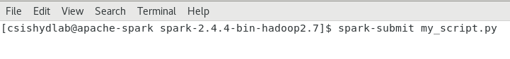
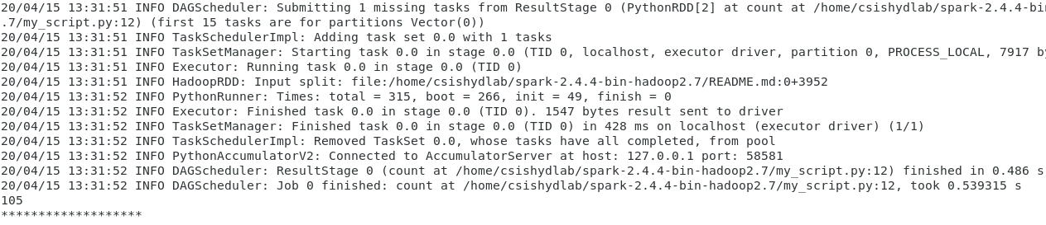
Standalone Applications(3)
Executing program
Using spark-submit , execute the program

Slide 7
Thank You!
Reference :
Learning Spark By Karau, Konwinski
Spark Documentation
In our next session: Spark Runtime Architecture

